Slide 1
Make it clear!
Use asynchronous flops to initialize
Use synchronous way to stall or flush

Slide 2
Case statement (general form)
case (expression)
alternative1 : statement1; // any of these statements could
alternative2 : statement2; // be a compound statement using
alternative3 : statement3; // begin/end
default : statement4 // always use default for synth stuff
endcase
localparam AND = 2’b00;
localparam OR = 2’b01;
localparam XOR = 2’b10;
case (alu_op)
AND : alu = src1 & src2;
OR : alu = src1 | src2;
XOR : alu = src1 ^ src2;
default : alu = src1 + src2;
endcase
Why always have a default?
Same reason as always having an else with an if statement.
All cases are specified, therefore no unintended latches.

Slide 3
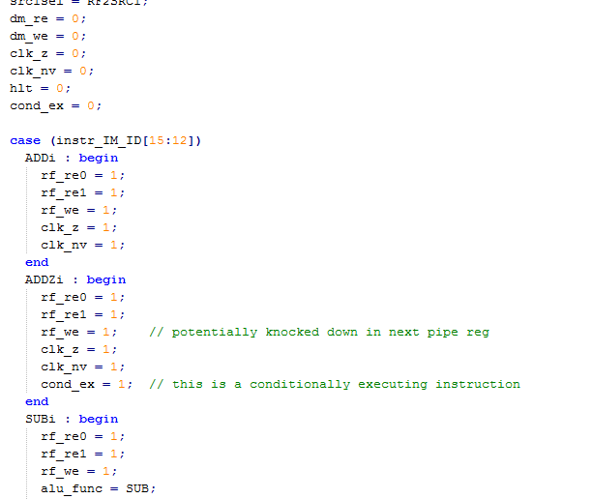
Where are Good Places to Use Case Statement in 552 Context
Main control portion of instruction decode lends itself well to case
State Machine Implementations also lend themselves to case implementations. We will look at this next
That is pretty much it. I would rather not see case used anywhere else.

Slide 4
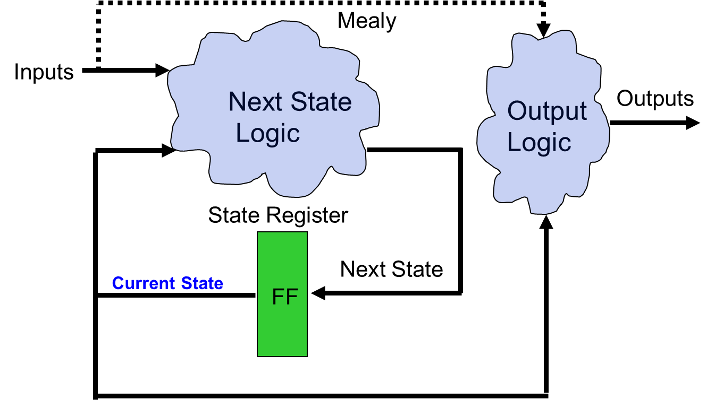
State Machines
State Machines:
Next State and output logic are combinational blocks, which have outputs dependent on the current state.
The current state is, of course, stored by a FF.
What is the best way to code State Machines?:
  Best to separate combinational (blocking) from sequential (non-blocking)
  Output logic and state transition logic can be coded in same always block since they have the same inputs
  Output logic and state transition logic are ideally suited for a case statement

Slide 5
State Diagrams
b=0 / Y=1
a=0 / Y=1
a=1 / Y=1
Outputs Y and Z are 0,
unless specified otherwise.
Is this Mealy or Moore?
a = 0
S0
a = 1/
Z = 1
S1
rst_n = 0
b = 1/ Z = 1, Y=1
S2
Lets code this

Slide 6
SM Coding
always @ (state,a,b)
case (state)
S0 : if (a) begin
nxt_state = S1;
Z = 1; end
else
nxt_state = S0;
S1 : begin
Y=1;
if (b) begin
nxt_state = S2;
Z=1; end
else
nxt_state = S1;
end
S2 : nxt_state = S0;
endcase
endmodule
module fsm(clk,rst_n,a,b,Y,Z);
input clk,rst_n,a,b;
output Y,Z;
localparam S0 = 2’b00;
localparam S1 = 2’b01;
localparam S2 = 2’b10;
reg [1:0] state,nxt_state;
always @(posedge clk,
negedge rst_n)
if (!rst_n)
state <= S0;
else
state <= nxt_state;
What problems do
we have here?

Slide 7
SM Coding (2nd try of combinational)
always @ (state,a,b)
nxt_state = S0; // default to reset
Z = 0; // default outputs
Y = 0; // to avoid latches
case (state)
S0 : if (a) begin
nxt_state = S1;
Z = 1;
end
S1 : begin
Y=1;
if (b) begin
nxt_state = S2;
Z=1; end
else nxt_state = S1;
end
default : nxt_state = S0;
endcase
Defaulting of assignments and having a default
to the case is highly recommended!

Slide 8
SM Coding Guidlines
Keep state assignment in separate always block using non-blocking “<=” assignment
Code state transition logic and output logic together in a always block using blocking “=” assignments
Assign default values to all outputs, and the nxt_state registers. This helps avoid unintended latches
Remember to have a default to the case statement.
  Default should be (if possible) a state that transitions to the same state as reset would take the SM to.
  Avoids latches
  Makes design more robust to spurious electrical/cosmic events.

Slide 9
Don’t make mistakes
1. Don’t assign a register from more than one always block; don’t assign any signal from more than one block
2. Blocking (combinational) v.s. non-blocking (sequential)
3. Never use a signal other than clk and rst_n as a trigger for a always block to design flops
4. Don’t write anything if you don’t know how it would be synthesized
5. Initial value only works with the reset signal, not the declaration part

Slide 10
Class Exercise: (code this branch predictor SM)
BR | Taken
BR
rst_n
BR & Taken
Taken1
Taken2
BR & Taken
Signal | Direction
clk | Input
rst_n | Input
BR | Input
Taken | Input
StateMSB | output
BR & Taken
BR & Taken
BR & Taken
NotTaken2
NotTaken1
BR
BR & Taken
BR | Taken
Submit to Dropbox on Moodle when finished

